Slide 1
HEALTH HAVEN
Team:
160121771001-Aayushi kar
160121771008-G. Sai Akshitha
160121771017-Rimsha Fathima

Slide 2
Introduction
Introduction: The healthcare industry is witnessing a growing demand for comprehensive solutions that cater to individuals seeking to improve their overall health and wellbeing.
Problems faced: Many people face difficulties in accessing all the necessary tools and information required to achieve a balanced and healthy lifestyle. Existing platforms often lack integration, making it challenging for users to track and manage their health effectively. People face issues regarding balancing and managing daily caloric intake, sleep, physical activity in the form of steps, adequate water intake, weight, and regular workout routines presents a complex challenge for individuals seeking to maintain and improve their overall health and well-being.

Slide 3
Problem Statement
Design a user-friendly website that integrates personalized exercise guidance, holistic health monitoring, and online shopping for health and fitness products. The challenge is to create an efficient platform for individuals to manage their well-being and fitness needs, prioritizing ease of use and data integration.

Slide 4
Abstract
"Health Haven" is designed for the development of a user-friendly and highly personalized website that caters to individuals seeking to improve their overall health and fitness. The current challenge is to create a platform where users can seamlessly navigate to their personalized dashboard after entering their login credentials. Within this personal dashboard, users should be able to input and track essential health metrics, including 'Calories intake,' 'Sleep,' 'Steps,' 'Water intake,' 'Weight,' and 'Workout.' Additionally, users must be able to set and monitor their individual health and fitness targets.
The primary objective is to develop a website that not only records these metrics but also provides tailored exercise recommendations to help users achieve their health and fitness goals. Furthermore, the platform should feature an e-commerce cart where users can conveniently purchase fitness products and select healthy food options, thereby promoting a holistic approach to wellbeing. The challenge lies in creating a seamless and effective system that addresses these multifaceted health and fitness needs, while ensuring the website's usability and personalized user experience.

Slide 5
Advantages
Convenience: "Health Haven" is a one-stop solution for health and fitness needs, offering easy access to all essential tools and services.
Personalization: The platform tailors exercise and diet recommendations to address each user's unique needs.
Streamlined Shopping: Users can purchase fitness products conveniently within the app.
Expert Guidance: Direct access to certified health consultants promotes holistic wellbeing.

Slide 6
Disadvantages
Data Privacy: Collecting sensitive personal data may raise privacy concerns, necessitating robust data security.
Technical Challenges: Maintaining and updating a full-stack web app can be complex, with potential compatibility and scalability issues.
Cost: Offering direct access to health consultants and e-commerce functions may increase operational costs, possibly impacting users financially.
User Adoption: Encouraging full utilization of all features could be a challenge, with varying levels of engagement among users.

Slide 7
Technologies used:
Front-End Development:
HTML/CSS: For creating the structure and styling of the website.
JavaScript: For interactive elements and user interface enhancements.
React or Angular: Popular front-end frameworks for building responsive and dynamic user interfaces.
Bootstrap or Material-UI: CSS frameworks for responsive and visually appealing design.
Back-End Development:
Node.js: A JavaScript runtime environment commonly used for building server-side applications.
Express.js: A web application framework for Node.js, providing routing and middleware.
Database Management: Technologies like MongoDB (NoSQL) for flexible data storage, or MySQL/PostgreSQL (SQL) for structured data.
RESTful API: To enable communication between the front-end and back-end

Slide 8
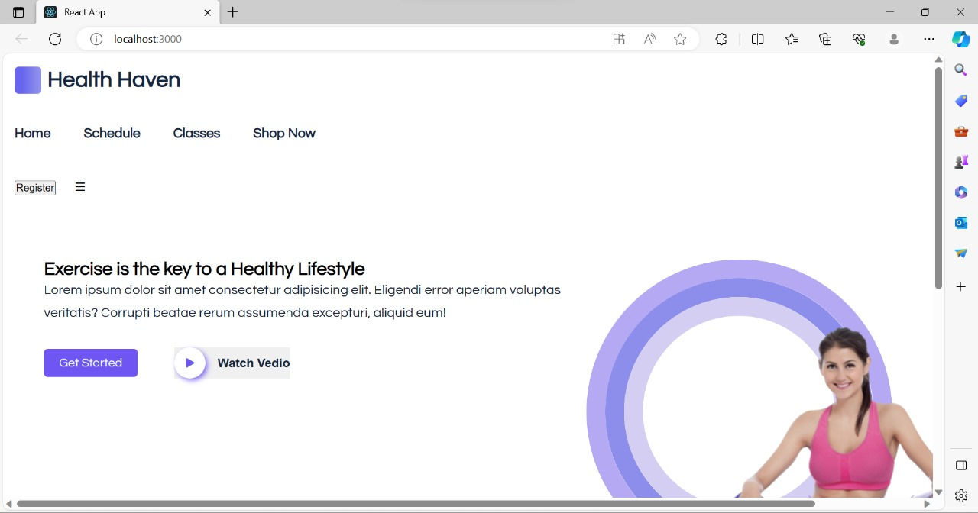
Code snippets

Slide 9
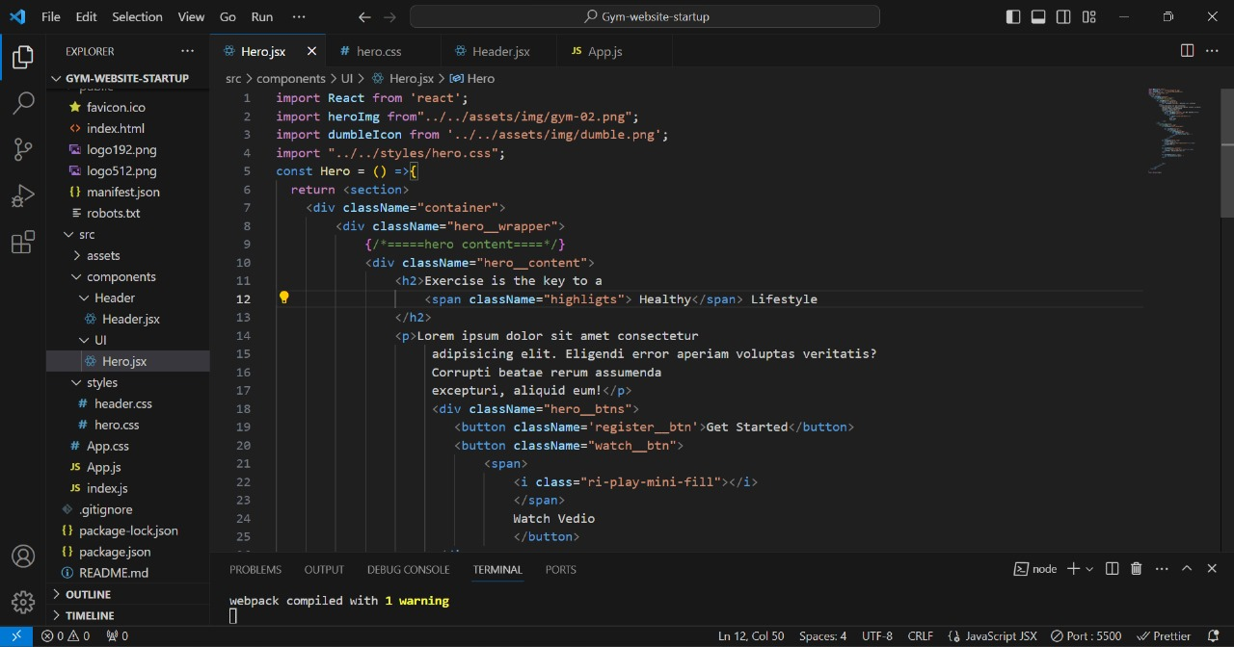

Slide 10


Slide 11
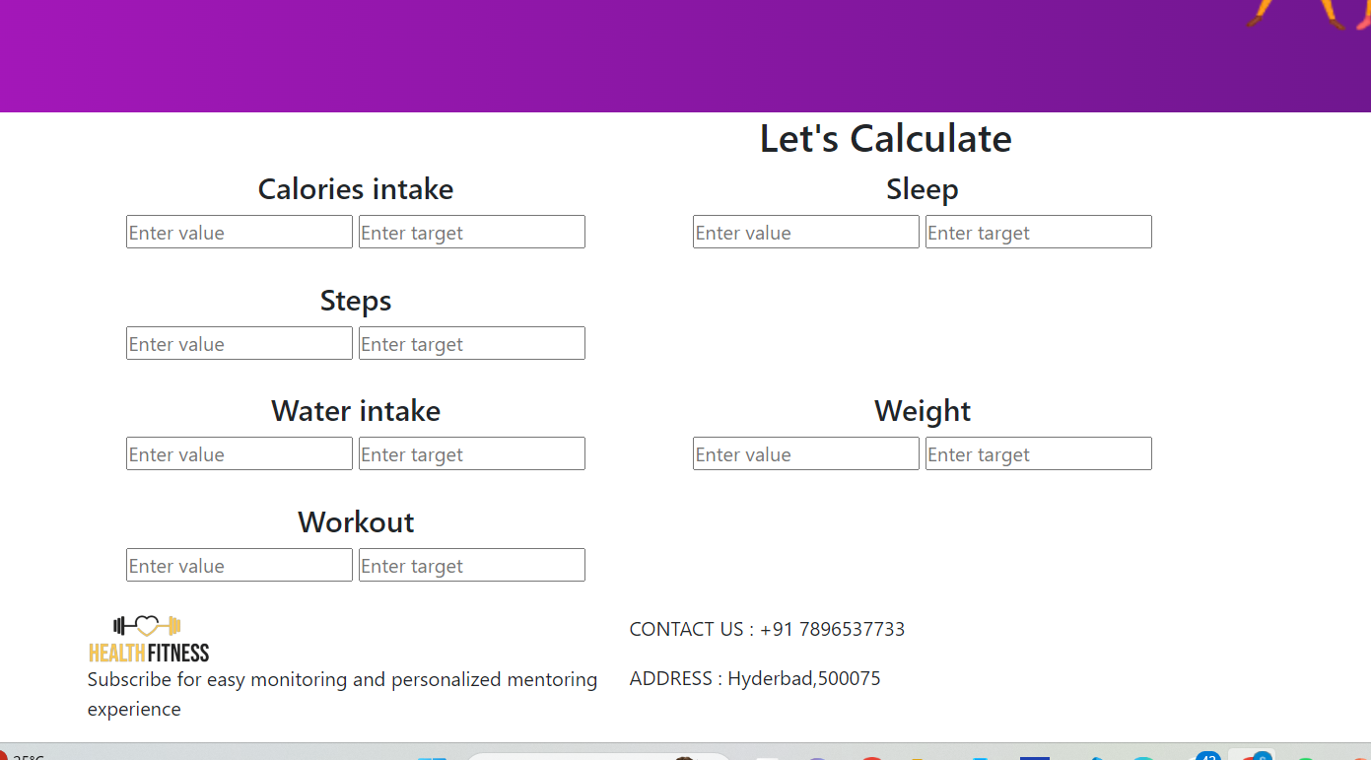

Slide 12
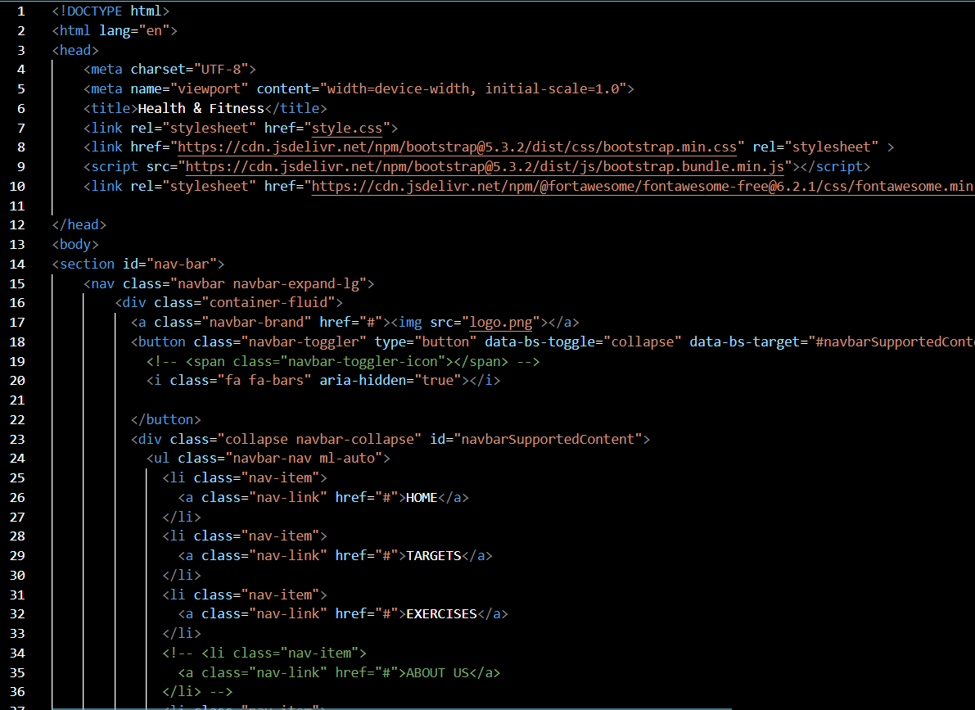

Slide 13
